Slide 1

Branches & GIT
Where to put what you do, and how.

Slide 2

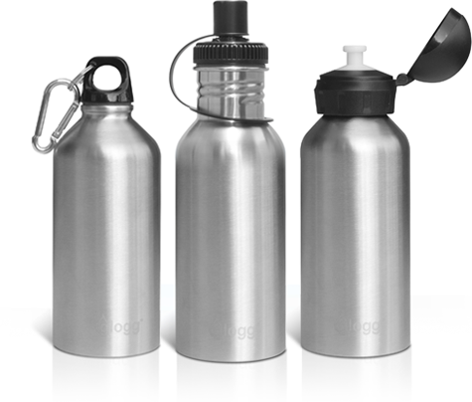

WHERE AND HOW

Slide 3


Releases
V/S

Slide 4
Releases
There are two major types of releases:
Public releases:
Community edition
Enterprise edition
Private releases:
Custom release for customers (one per customer!)

Slide 5
Public releases
There are three types of public releases
Maintenance: Only bug fixes
Minor: New features
Major: Big changes!

Slide 6
Public releases
There are three types of public releases
Maintenance: Only bug fixes
Minor: New features
Major: Big changes!

Slide 7
Maintenance releases
There are only bug fixes in this releases
No new features
Easy adoption for existing customers: no risk of a new feature breaking something
Only the last digit changes. Example. 3.0.1, 3.0.2, 3.0.3

Slide 8
Minor releases
There are new features and bug fixes in this releases
The new features do not represent a huge change
Only the middle digit changes. Example. 3.1.0, 3.4.0, 2.5.0 (note that the last digit is always a zero)

Slide 9
Major releases
Something big changed
From jBilling 1 to 2: switch from JBoss – EJB to Tomcat - Spring
From jBilling 2 to 3: new GUI and adoption of Grails for UI layer
Only the first digit changes. Example. 1.0.0, 2.0.0, 3.0.0 (note that the last two digits are always zero)

Slide 10
Community and Enterprise releases
The community is simply a parallel release with some missing features
Pricing Models
Plans
Security
When EE releases, CE releases as well: major, minor, maintenance

Slide 11
Branches
The main jBilling repository is often call ‘enterprise’
It has many branches to facilitate releases

Slide 12
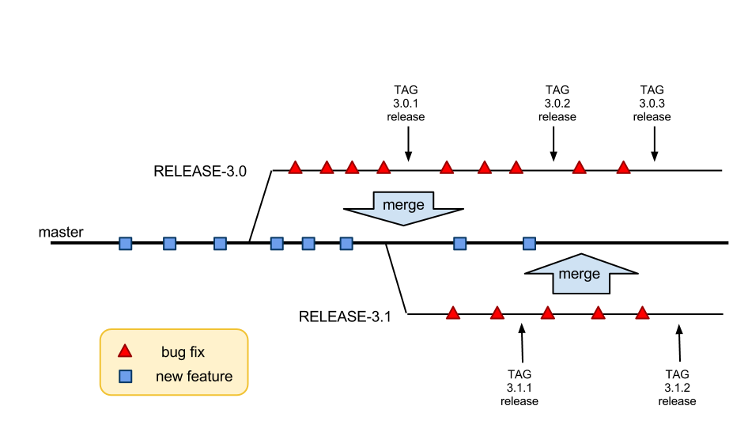
Master and release branches

Slide 13
enterprise/master
Takes new features
The goal is a new minor release
It is merged with a release branch often to pick up bug fixes

Slide 14
enterprise/RELEASE-x.x
Starts from ‘master’ when a new release is done
Then it takes only bug fixes
There are several of them, one per minor release
They are tagged every time a release is done

Slide 15
enterprise/demo
This is running on demo.jbilling.com port 8080
It is used by sales and sometimes by QA
It is simply useful to have always a place where to access jBilling
It runs the code from a release branch
It has a different DB with some sample data
It periodically merges with the release branch, but it has to keep its DB (jbilling_test.sql)

Slide 16
enterprise/SaaS
It has the code that will be used for the jBilling SaaS service
It runs the code from a release branch
It has a few code differences
It periodically merges with the release branch

Slide 17
Private releases
We always start a new project with a new repository
The repository is hosted in github
The repository is started from a release branch: use the latest stable code
The repository starts from the Enterprise Edition.
It is common to only have a master branch

Slide 18
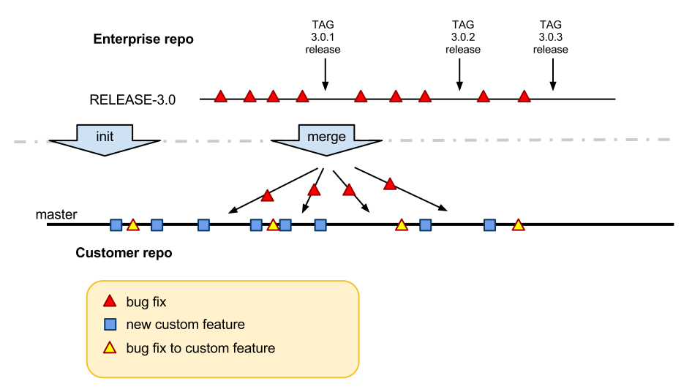
Enterprise and private repos

Slide 19
GIT
We use GIT for all the code versioning
GIT is tough to learn, but then it is really helpful.
The actual repositories are in GitHub

Slide 20
GIT – we need to …
Review the history
See what is different between two commits
Merge
Cherry pick
Find out who did some changes

Slide 21
Github
Github is great and easy to use for
Quickly review some file
Review the history of a file
Find a list of commits
Find out who did some changes
Use an avatar!

Slide 22
GIT commands
With Basic Work -flow
remote-add
fetch
checkout
add
commit
push

Slide 23
GIT commands
remote-add
When working for a project, one of the first things you will need to find out is where the repository for that
project is. Then add it to your own personal computer:

Slide 24
GIT commands
remote-add
git remote add blue_repo git@github.com:emilc/blue.git

Slide 25
GIT commands
fetch
Now you need to fetch the content of this remote repository in your local box:
git fetch blue_repo

Slide 26
GIT commands
checkout
It is helpful to have a branch in your local box that points to the master branch of the project:
git checkout -b blue blue_repo/master

Slide 27
GIT commands
add
In a nutshell, you will use git add to start tracking new files and also to stage changes to already tracked files.

Slide 28
GIT commands
Some global settings
Make sure you git config has been set for the following variables:
git config --global user.name "Nikhil Sharma"
git config --global user.email nikhils@jbilling.com
git config --global core.autocrlf=false
git config --global --add color.ui true
Use your jBilling email id in the email attribute. This will ensure that you get all the messages from jBilling build admin.

Slide 29
GIT commands
commit
git commit -m '#Ticket-no <Commit Message>'
[master 68aa034] #Ticket-no <Commit Message>
1 files changed, 2 insertions(+), 1 deletions(-)

Slide 30
Checks To Do Before Pushing Code
Enterprise release or master branches
As a checklist or rule, always ensure the following:
RUN grails prepare-test
Execute WS test cases using: ant test
Make sure the test pass or fix if need be
Client Branches:
Initialize DB with data.sql
Execute WS test cases using: ant -f client-specific-build.xml
Make sure the test pass or fix if need be
And then push.

Slide 31
GIT commands
push
Publish all the changes
git push blue_repo blue:master
git push repository local_branch:remote_branch

Slide 32
Some More GIT Commands
log
diff
merge
cherry-pick
stash

Slide 33
GIT commands
log
To see a chronological list of the parents of any branch, you can run git log when you are in that branch.
git log
git log --oneline --graph

Slide 34
Diff two commits
What changed between two commits? This is often needed
Git diff commit1..commit2 -- file
git diff 4ec6f7..8750b -- classes/com/sapienter/jbilling/server/payment/PaymentBL.java

Slide 35
Moving code across branches
‘merge’ and ‘cherry-pick’ are used to get code from one branch to another
There are fundamental differences between the two!

Slide 36

Merge
Merge preserves the order and time of each commit
Merge makes the receiving branch compatible with the source branch
Once you merge it is easy to merge later on

Slide 37
Use merge when…
Taking bug fixes from a release branch to the master branch
Taking bug fixes from a release branch to a customer repository
You need to regularly merge the release branch with the customer repository!

Slide 38
Use merge when…
Yes, even when the customer repository has many customizations.
The branches have to be made compatible
This is critical, otherwise the bug fixes need to be redone all the time!

Slide 39
Merge Command
merge
You can merge any branch into your current branch with the git merge command.
git merge removals
Updating 8bd6d8b..8f7c949
Fast-forward
more.txt | 1 -
test.txt | 1 -
2 files changed, 0 insertions(+), 2 deletions(-)
delete mode 100644 more.txt
delete mode 100644 test.txt

Slide 40

Cherry-pick
Cherry-pick will copy a commit from one branch to another. It is a new commit.
The new commit is just that, it really has not ‘connection’ to the original commit.
Things like date or author are not copied, only the code changes are

Slide 41
Use cherry-pick when…
Bring a new feature from enterprise to a customer repo, or vice versa.
Bring a bug fix or other change between to incompatible branches
Otherwise, use ‘merge’

Slide 42

GIT STASH
stash
Often, when you’ve been working on part of your project, things are in a messy
state and you want to switch branches for a bit to work on something else. The
problem is, you don’t want to do a commit of half-done work just so you
can get back to this point later.
The answer to this issue is the git stash command.
Stashing takes the dirty state of your working directory
— that is, your modified tracked files and staged changes
— and saves it on a stack of unfinished changes that you can reapply at any time.
git stash save
git stash list
git stash pop

Slide 43

Typical Scenario Work - Flows
Scenario 1 : You are working for a customer with his/her repo's named as
cool_cust_repo
and you are assigned a ticket #1234 saying that they want 'x' custom feature
for themselves.
Assuming you do have the customer's repo already setup at your system by
the following commands.
remote-add
fetch
checkout
What would you do ?

Slide 44
Typical Scenario Work - Flows
Here, since its the client which needs the customization (this is very normal)
we don't want this code only for the client. So, we will just implement the
Requirement for the 'x' feature and after testing it push
it into the customer's repo.
pull - The latest changes from customer repo.
commit – At the customer repo (After testing).
Push – to the release repo.
Just try to make this as a single commit going into the
client's repo but this is only a GENERAL
statement not to be strictly followed.

Slide 45
Typical Scenario Work - Flows
Scenario 2 : You are working for a customer with his/her repo's named as
cool_cust_repo and more specifically you are
already working on an assigned task lets say, ticket #1234.
But the customer discovers some other bug in the system which needs
immediate fix first leaving you assigned with a fresh ticket #1235.
What would you do ?

Slide 46
Typical Scenario Work - Flows
Here, you don't want to loose the changes that you have been doing
and also you don't want to commit the fix along-with the code meant to
go in with the feature you were working on. So, you will use git's stash command here,
to save your changes and then work on the ticket #1235, push it and then pop your
stashed change and then after completing the rest of the work push to client's repo.
pull - The latest changes from customer repo.
Do the changes (Suppose they are 50% done).
Stash – Stash the change temporarily.
Do changes for #1235
commit – At the customer repo (After testing).
Push – to the release repo.
Pop – Pop the changes to #1234 and find your working copy as you left earlier.
commit and push the code with changes for #1234
.

Slide 47
Typical Scenario Work - Flows
Scenario 3 : You are working for a customer with his/her repo's named as
cool_cust_repo and you are assigned a ticket #2134 saying that there is
a bug in some feature of jBilling. Assuming you do have the customer's
repo already setup at your system by the following commands.
remote-add
fetch
checkout
What would you do ?

Slide 48
Typical Scenario Work - Flows
Here, you must first fix the bug on some release repo and then when
you are done fixing, testing,commiting the code, you then checkout to
the client's repo and then cherry-pick the commit that you just did to the
client's repo. Then after testing the change on the client's repo,
push the change to both the release and customer repo.
checkout – to release repo.
pull - The latest changes from release repo.
commit – At the release repo (After testing).
Push – to the release repo.
checkout – Go back to customer's repo.
cherry-pick – You need to cherry-pick the commit you just did at release repo.
Push – To the customer repo.

Slide 49

Useful Resources
Find the most typical uses in the wiki:
https://pm.jbilling.com/projects/jbilling/wiki/GIT_-_Common_examples
http://gitref.org
Pro-Git

Slide 50

Questions

Slide 51

Thank You

